Slide 1

Natural Language Processing
Naeemullah Khan
naeemullah.khan@kaust.edu.sa
KAUST Academy
King Abdullah University of Science and Technology

Slide 2
Vector Space Models
Vector space models
Advantages
Applications

Slide 3
Why learn vector space models?
Where are you
Where are you
heading?
What is your age?
from?
How old are you?
Different meaning
Same Meaning

Slide 4



Vector space models applications
You eat cereal from a bowl
You buy something and someone else sells it
Information Extraction
Machine Translation
Chatbots

Slide 5

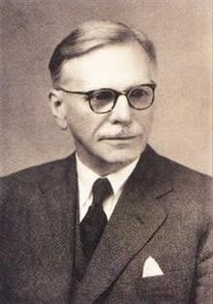
Fundamental concept
“You shall know a word by the company it keeps”
Firth, 1957
(Firth, J. R. 1957:11)

Slide 6
Summary
Represent words and documents as vectors
Representation that captures relative meaning

Slide 7
Idea
Co-occurrence Vector representation
Relationships between words/documents

Slide 8
Word by Word Design
Number of times they occur together within a certain distance k
k=2
I like simple data
I prefer simple raw data
simple raw like I
data
2 1 1 0
n

Slide 9
Word by Document Design
Number of times a word occurs within a certain category
Corpus
Entertainment Economy ^{Machine}
Learning
Machine
E | ntertainment | Economy | Learning
data | 500 | 6620 | 9320
film | 7000 | 4000 | 1000

Slide 10
Vector Space
10000
Entertainment Economy
ML
data
500
7000
6620
4000
9320
1000
Entertainment
film
film
5000
Economy
1000
ML
Measures of “similarity:”
Angle Distance
1000
5000
data
10000

Slide 11
Euclidean distance
Corpus A: (500,7000)
10000
Entertainment
Corpus B: (9320,1000)
film
5000
ML
1000
1000
5000
data
10000

Slide 12




Euclidean distance
Corpus A: (500,7000)
10000
Entertainment
Corpus B: (9320,1000)
film
5000
ML
1000
1000
5000
data
10000

Slide 13


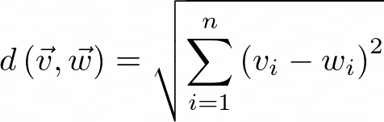
Euclidean distance for n-dimensional vectors
 | data | boba | ice-cream
AI | 6 | 0 | 1
drinks | 0 | 4 | 6
food | 0 | 6 | 8
Norm of ( -
)

Slide 14
Euclidean distance in Python
# Create numpy vectors v and w v = np.array([1, 6, 8])
w = np.array([0, 4, 6])
# Calculate the Euclidean distance d d = np.linalg.norm(v-w)
# Print the result
print("The Euclidean distance between v and w is: ", d)
The Euclidean distance between v and w is: 3

Slide 15
Euclidean distance vs Cosine similarity
Cosine similarity when corpora are different sizes
40
Agriculture corpus (20,40)
Euclidean distance: d₂ < d₁
Angles comparison: β >
α
eggs
30
d₁
d₂
20
Food corpus (5,15)
History corpus (30,20)
α
β
10
The cosine of the angle between the vectors
10
20
disease
30

Slide 16


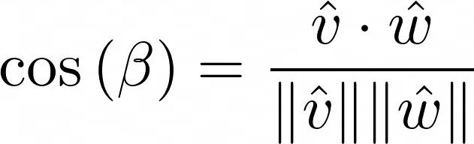

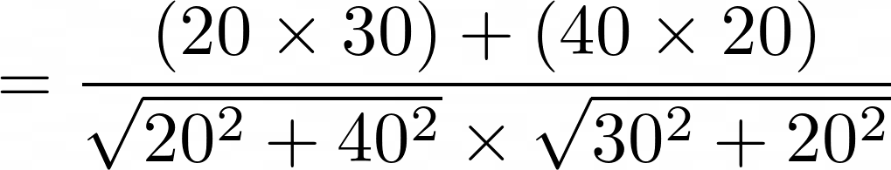

Cosine Similarity
40
Agriculture corpus (20,40)
eggs
30
20
10
β
History corpus (30,20)
10
20
disease
30

Slide 17




Cosine Similarity
40
40
eggs
30
eggs
30
20
20
Dissimilar
Similar
10
10
β
10
20
disease
30
10
20
disease
30

Slide 18

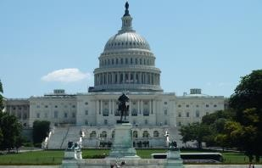

Manipulating word vectors
USA
Washington
DC
Russia

Slide 19






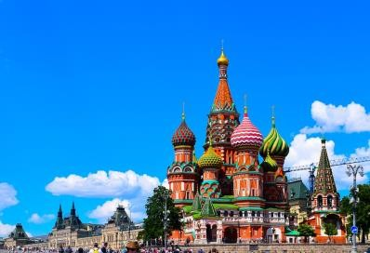



Manipulating word vectors
USA (5,6)
Washington - USA =
Washington (10,5)
Russia (5,5)
Russia +
=
(10,4)
Moscow (9,3)
Japan (4,3)
Turkey (3,1)
Tokyo(8.5, 2)
Ankara(8.5, 0.9)
Moscow
[Mikolov et al, 2013, Distributed Representations of Words and Phrases and their Compositionality]

Slide 20


Visualization of word vectors
d > 2
oil | 0.20 | … | 0.10
gas | 2.10 | … | 3.40
city | 9.30 | … | 52.1
town | 6.20 | … | 34.3
oil & gas
How can you visualize if your representation captures these relationships?
town & city

Slide 21
Visualization of word vectors
d > 2
d = 2
oil | 0.20 | … | 0.10
gas | 2.10 | … | 3.40
city | 9.30 | … | 52.1
town | 6.20 | … | 34.3
oil | 2.30 | 21.2
gas | 1.56 | 19.3
city | 13.4 | 34.1
town | 15.6 | 29.8
PCA

Slide 22
Visualization of word vectors
village
town
country
city
gas
oil
happy
joyful
petroleum
sad

Slide 23
Moving towards more advanced word vectors
One-hot vectors
Word embeddings

Slide 24


Some basic applications of word embeddings
village
town
country
happy
city
gas oil
petroleum
sad
joyful
Semantic analogies and similarity
Sentiment analysis
Classification of customer feedback

Slide 25



Advanced applications of word embeddings
Machine translation
Information extraction
Question answering

Slide 26
Integers
Word | Number
a | 1
able | 2
about | 3
... | ...
hand | 615
… | …
happy | 621
... | ...
zebra | 1000

Slide 27
Integers
+ Simple
hand < happy <
zebra
1000
- Ordering: little semantic sense
615 ?! 621
?!

Slide 28
One-hot vectors
“a”
“happy”
“zebra”
 | 1 | a |  | 0 | a
 | 0 | able |  | 0 | able
 | 0 ⋮ | about ... | 0 ... 1000 ⋮ |  | about ...
 | 0 | a
 | 0 | able
 | 0 | about
 | ⋮ | ...
 | 0 | hand
 | ⋮ | …
 | 0 | happy
 | ⋮ | ...
 | 1 | zebra
...
0
⋮
0
⋮
0
hand
…
happy
...
zebra
rows
0
⋮
hand
…
1
happy
⋮
0
...
zebra

Slide 29
One-hot vectors
Word Number
“happy”
a able about
...
hand
…
1
2
3
... 615
…
1 0
2 0
3 0
... ⋮
615 0
… ⋮
a able about
...
hand
…
happy
621
621 1
happy
...
zebra
...
1000
... ⋮
1000 0
...
zebra

Slide 30
One-hot vectors
0
⋮
1
⋮
0
a
…
happy
...
Zyzzyva
~10k—1M+
rows
+ Simple
+ No implied ordering
- Huge vectors
d(paper, excited)
= d(paper, happy)
= d(excited, happy)
happy
paper
- No embedded meaning
excited

Slide 31
Meaning as vectors
rage anger
(-2.52) (-2.08)
spider
(-1.53)
boring
(-0.91)
-1
paper
(0.03)
kitten
(1.09)
1
happy excited
(1.75) (2.31)
negative
-2
0
2
positive

Slide 32
Meaning as vectors
concrete
paper (0.03, 0.79)
1
spider (-1.53, 0.41)
snake (-1.53, 0.41)
-2 -1
puppy
(0.98, 0.57)
kitten
(1.09, 0.57)
negative
0
1
2
positive
rage (-2.52, -0.54)
anger (-2.08, -0.71)
excited
(2.31, -0.54)
boring
thought (0.03, -0.93)
abstract
happy
(1.75, -0.81)
-1

Slide 33
Word embedding vectors
“happy”
0.123
⋮
-4.059
⋮
1.891
+ Low dimension
~100—~1000
rows
+ Embed meaning
e.g. semantic distance
forest ≈ tree
e.g. analogies
forest ≉ ticket
Paris:France :: Rome:?

Slide 34
Terminology
word vectors
integers
one-hot vectors
word embedding vectors
“word vectors”
word embeddings

Slide 35


Word embedding process
Hyperparameters
Word embedding size ...
Embedding method
Machine learning model
Corpus
Transformation
words
General-
purpose
e.g. Wikipedia
Specialized
e.g. contracts, law books
Learning task
“I think [???] I am”
Self-supervised
= unsupervised
+ supervised
integers, vectors
Words in context
Meaning
Word embeddings

Slide 36
Basic word embedding methods
word2vec (Google, 2013)
Continuous bag-of-words (CBOW)
Continuous skip-gram / Skip-gram with negative sampling (SGNS)
Global Vectors (GloVe) (Stanford, 2014)
fastText (Facebook, 2016)
Supports out-of-vocabulary (OOV) words

Slide 37
Advanced word embedding methods
Deep learning, contextual embeddings
BERT (Google, 2018)
Tunable pre-trained models available
ELMo (Allen Institute for AI, 2018)
GPT-2 (OpenAI, 2018)

Slide 38
Continuous bag-of-words word embedding process
Embedding method
Corpus
“I think [???] I am”
CBOW
Transformation
“therefore”
Word embeddings

Slide 39
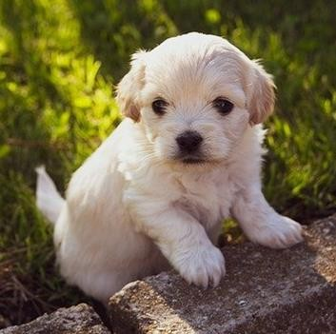
Center word prediction: rationale
Corpus
Transformation
CBOW
The little ? is barking
dog puppy hound terrier
...

Slide 40
Creating a training example
Corpus
Transformation
CBOW
center word
I am
happy
because I
am learning
window
window size = 5
context words
C = 2
context half-size

Slide 41
From corpus to training
Corpus
Transformation
CBOW
Embedding method
Corpus
am learning
Transformation
Context words
Context words
Center word
CBOW
I am happy because I
I am because I happy
am happy I am because
happy because am learning I
Predicted center word
Word embeddings

Slide 42
From corpus to training
Corpus
Transformation
CBOW
Embedding method
Corpus
am learning
Transformation
Context words
Context words
Center word
CBOW
I am happy because I
I am because I happy
am happy I am because
happy because am learning I
Predicted center word
Word embeddings

Slide 43
From corpus to training
Corpus
Transformation
CBOW
Embedding method
Transformation
Context words
Corpus
Context words
Center word
CBOW
I
am happy because I am
learning
I am because I am happy I am
happy because
happy because am learning
I
Predicted center word
Word embeddings

Slide 44
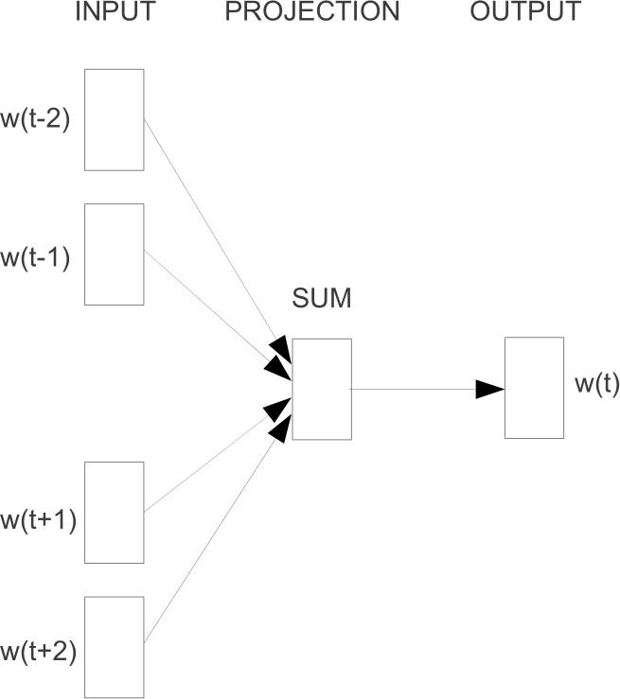
CBOW in a nutshell
Source: Mikolov, T., Chen, K., Corrado, G.S., & Dean, J. (2013). Efficient Estimation of Word Representations in Vector Space

Slide 45
Cleaning and tokenization matters
Letter case
“The” == “the” == “THE” → lowercase / upper case

Slide 46
Cleaning and tokenization matters
Letter case
“The” == “the” == “THE” → lowercase / upper case
Punctuation
, ! . ? → .
“ ‘ « » ’ ” → ∅
… !! ??? → .

Slide 47
Cleaning and tokenization matters
Letter case
“The” == “the” == “THE” → lowercase / upper case
Punctuation
, ! . ? → .
“ ‘ « » ’ ” → ∅
… !! ??? → .
Numbers
1 2 3 5 8 → ∅ 3.14159 90210 → as is/<NUMBER>

Slide 48
Cleaning and tokenization matters
Letter case
“The” == “the” == “THE” → lowercase / upper case
Punctuation
, ! . ? → .
“ ‘ « » ’ ” → ∅
… !! ??? → .
Numbers
1 2 3 5 8 → ∅ 3.14159 90210 → as is/<NUMBER>
Special characters
∇ $ € § ¶ ** → ∅

Slide 49
Cleaning and tokenization matters
Letter case
“The” == “the” == “THE” → lowercase / upper case
Punctuation
, ! . ? → .
“ ‘ « » ’ ” → ∅
… !! ??? → .
Numbers
1 2 3 5 8 → ∅ 3.14159 90210 → as is/<NUMBER>
Special characters
∇ $ € § ¶ ** → ∅
Special words
😊 #nlp → :happy: #nlp

Slide 50
Example in Python: corpus
Who
❤️
"word embeddings" in
2020
?
I do!!!
emoji
punctuation
number

Slide 51
Example in Python: libraries
# pip install nltk # pip install emoji
import nltk
from nltk.tokenize import word_tokenize
import emoji
nltk.download('punkt') # download pre-trained Punkt tokenizer for English

Slide 52
Example in Python: code
corpus = 'Who ❤️ "word embeddings" in 2020? I do!!!'
data = re.sub(r'[,!?;-]+', '.', corpus)
→ Who ❤️ "word embeddings" in 2020. I do.

Slide 53
Example in Python: code
corpus = 'Who ❤️ "word embeddings" in 2020? I do!!!'
data = re.sub(r'[,!?;-]+', '.', corpus)
data = nltk.word_tokenize(data) # tokenize string to words
→ ['Who', '❤️', '``', 'word', 'embeddings', "''", 'in', '2020', '.', 'I', 'do', '.']

Slide 54
Example in Python: code
corpus = 'Who ❤️ "word embeddings" in 2020? I do!!!'
data = re.sub(r'[,!?;-]+', '.', corpus)
data = nltk.word_tokenize(data) # tokenize string to words
data = [ ch.lower() for ch in data
if ch.isalpha()
or ch == '.'
or emoji.get_emoji_regexp().search(ch)
]
→ ['who', '❤️', 'word', 'embeddings', 'in', '.', 'i', 'do', '.']

Slide 55
Sliding window of words in Python
def get_windows(words, C): i = C
while i < len(words) - C: center_word = words[i]
context_words = words[(i - C):i] + words[(i+1):(i+C+1)]
yield
context_words, center_word
i += 1
I | am | happy | because | I | am | learning
0 | 1 | 2 | 3 | 4 | 5 | 6

Slide 56
Sliding window of words in Python
def get_windows(words, C):
...
yield context_words, center_word
for x, y in get_windows(
['i', 'am', 'happy', 'because', 'i', 'am', 'learning'], 2
):
print(f'{x}\t{y}')

Slide 57
Sliding window of words in Python
for x, y in get_windows(
['i', 'am', 'happy', 'because', 'i', 'am', 'learning'], 2
):
print(f'{x}\t{y}')
→ ['I', 'am', 'because', 'I'] happy
['am', 'happy', 'I', 'am']
['happy', 'because', 'am', 'learning']
because
I

Slide 58
Transforming center words into vectors
Corpus
Vocabulary
I am happy because I am learning
am, because, happy, I, learning
am because happy
One-hot
vector
I
learning
am because happy
I
learning
1
0
0
0
0
0
1
0
0
0
0
0
1
0
0
0
0
0
1
0
0
0
0
0
1

Slide 59
Transforming context words into vectors
Average of individual one-hot vectors
I am because I I am because I
am because happy
I
learning
0
0
0
1
0
1
0
0
0
0
0
1
0
0
0
0
0
0
1
0
0.25
0.25
0
0.5
0
+
+
+
/ 4
=

Slide 60
Final prepared training set
Context words | Context words vector | Center word | Center word vector
I am because I | [0.25; 0.25; 0; 0.5; 0] | happy | [0; 0; 1; 0; 0]
am happy I am [0.5; 0; 0.25; 0.25; 0] because [0; 1; 0; 0; 0]
happy because am learning [0.25; 0.25; 0.25; 0; 0.25] I [0; 0; 0; 1; 0]

Slide 61






Architecture of the CBOW model
Input layer Hidden layer
Output layer
Hyperparameters
N: Word embedding size ...
Context words
vector
⋮
⋮
⋮
⋮
⋮
⋮
Center word vector
W₁
weights
b₁
biases
W₂
weights
b₂
biases
x =
V
“I am happy because I am learning”
* V = 5
ŷ =
V
ReLU
softmax
V
N
V
x
h
ŷ

Slide 62


Dimensions (single input)
Input layer Hidden layer
Output layer
⋮
⋮
⋮
⋮
⋮
⋮
W₁ N x V
b₁ N x 1
W₂ V x N
b₂ V x 1
ReLU
softmax
z₁ = W₁x + b₁
N x 1
z₂ = W₂h + b₂
V x 1
x
V x 1
h
N x 1
ŷ
V x 1
h = ReLU(z )
N x 1
ŷ = softmax(z ) V x 1
1
2

Slide 63
Dimensions (single input)
Column vectors
z₁ = W₁x + b₁
z₁ =
W₁ =
N x V
x =
b₁ =
N x 1
N x 1
V x 1
Row vectors
z₁ = xW₁ + b₁
T
b₁ =
1 x N
W₁ =
N x V
b₁ = 1 x N
x =
1 x V

Slide 64

Architecture of the CBOW Model:
deeplearning.ai
Dimensions 2

Slide 65
Dimensions (batch input)
Input layer
Hidden layer
Output layer
Context words vectors
* matrix
⋮
⋮
⋮
⋮
⋮
⋮
W₁ N x V
B₁ N x m
W₂ V x N
B₂ V x m
X =
_{x}(1)
…
_{x}(m)
V
ReLU
softmax
m
Z₁ = W₁X + B₁ N x m
Z₂ = W₂H + B₂
V x m
X
V x m
H
N x m
Ŷ
V x m
H = ReLU(Z )
N x m
Ŷ = softmax(Z ) V x m
1
2
^{b}1 ^{→ B}1 ^{= b}1 ^{… b}1
m
N broadcasting

Slide 66
Dimensions (batch input)
Input layer Hidden layer
Output layer
Context words matrix
⋮
⋮
⋮
⋮
⋮
⋮
Predicted center word matrix
W₁
B₁
W₂
B₂
X =
_{x}(1)
…
_{x}(m)
V
Ŷ =
_{ŷ}(1)
…
_{ŷ}(m)
V
ReLU
softmax
m
m
X
V x m
H
N x m
Ŷ
V x m

Slide 67
Architecture of the CBOW Model
deeplearning.ai
Activation Functions

Slide 68
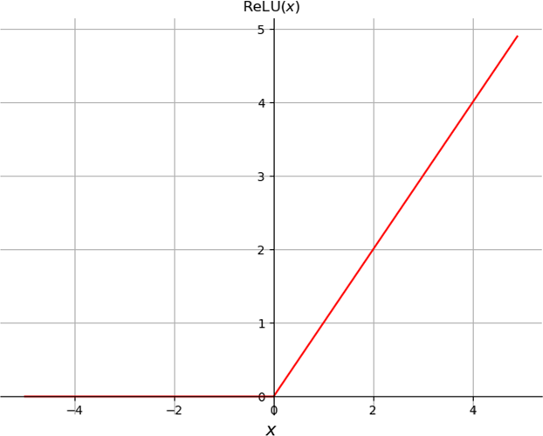
Rectified Linear Unit (ReLU)
ReLU(x) = max(0, x)
Input layer Hidden layer
⋮
⋮
⋮
⋮
z₁ = W₁x + b₁
h = ReLU(z₁)
W₁
b₁
z₁
h
5.1
-0.3
5.1
0
ReLU
⋮
ReLU
⋮
-4.6
0.2
0
0.2
x
h

Slide 69
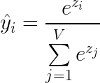
Softmax
Hidden layer
Output layer
⋮
⋮
⋮
⋮
z = W₂h + b₂
W₂
b₂
ŷ = softmax(z)
z
ŷ
z₁
⋮
z_{i}
⋮
z_{V}
ŷ₁
⋮
ŷ_{i}
⋮
ŷ_{V}
a
⋮
happy
⋮
softmax
softmax
V
V
zebra
Probabilities of being center word
h
ŷ
∈
_{ℝ}K
∈ [0, 1]^{K}
~probabilities
softmax
𝝨=1

Slide 70
Softmax: example
z
exp(z)
ŷ = softmax(z)
9
8
11
10
8.5
8103
2981
59874
22026
4915
0.083 am
^{0.03} because
0.612 _{happy}
0.225 _{I}
^{0.05} learning
exp
/ 𝝨
* Predicted center word
𝝨=97899
𝝨=1

Slide 71
Loss
x
Context words vector
ŷ
Predicted center word vector
y
Actual center word vector
CBOW
Input
Machine learning
model
Prediction
Truth
Parameters
W₁, b₁, W₂, b₂
minimize
Loss
error
adjust
cross-entropy loss

Slide 72
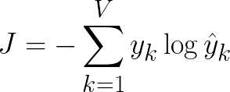
Cross-entropy loss
I am happy because I am learning
y ⊙ log(ŷ)
0
0
y 0 | am | ŷ 0.083 |  | log(ŷ)
0 | because | 0.03
1 | happy | 0.611 | log |  | ⊙ y
0 | I | 0.225
0 | learning | 0.05
-2.49
-3.49
-0.49
-1.49
-2.49
-0.49
- 𝝨
J = 0.49
0
0
Actual
y =
Predicted
ŷ =
y₁
⋮
y_{V}
ŷ₁
⋮
ŷ_{V}

Slide 73
Cross-entropy loss
y
0
0
ŷ
log(ŷ)
y ⊙ log(ŷ)
0
0
am
0.96
0.01
0.01
0.01
0.01
-0.04
-4.61
-4.61
-4.61
-4.61
because
1
happy
log
⊙ y
-4.61
- 𝝨
J = 4.61
0
0
I
learning
0
0
>
_{J}(correct) _{= 0.49}

Slide 74
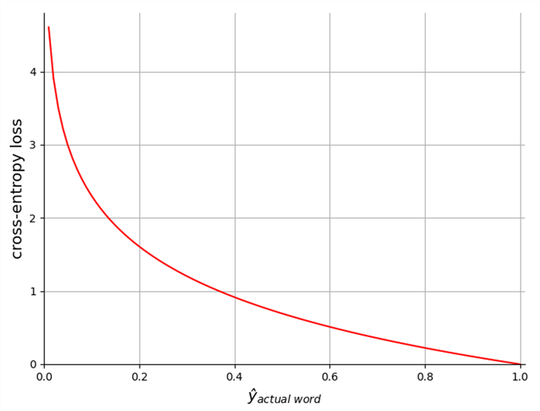
Cross-entropy loss
J = -log ŷ_{actual}
word
incorrect predictions: penalty
y |  | ŷ
0 | am | 0.96
0 | because | 0.01
1 | happy | 0.01 | * J = 4.61
0 | I | 0.01
0 | learning | 0.01
correct predictions: reward

Slide 75
Intrinsic evaluation
Test relationships between words
Analogies
Semantic analogies
“France” is to “Paris” as “Italy” is to <?>
Syntactic analogies
“seen” is to “saw” as “been” is to <?>
⚡ Ambiguity
“wolf” is to “pack” as “bee” is to <?> → swarm? colony?

Slide 76
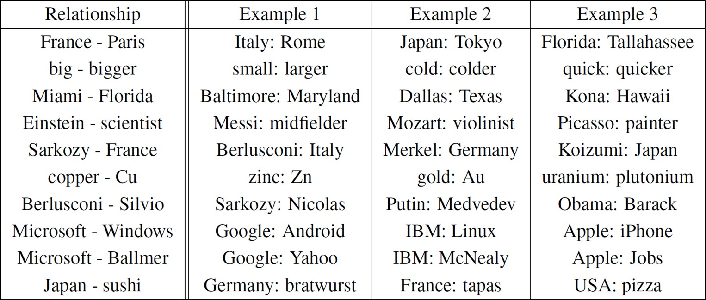
Intrinsic evaluation
Test relationships between words
Analogies

Slide 77
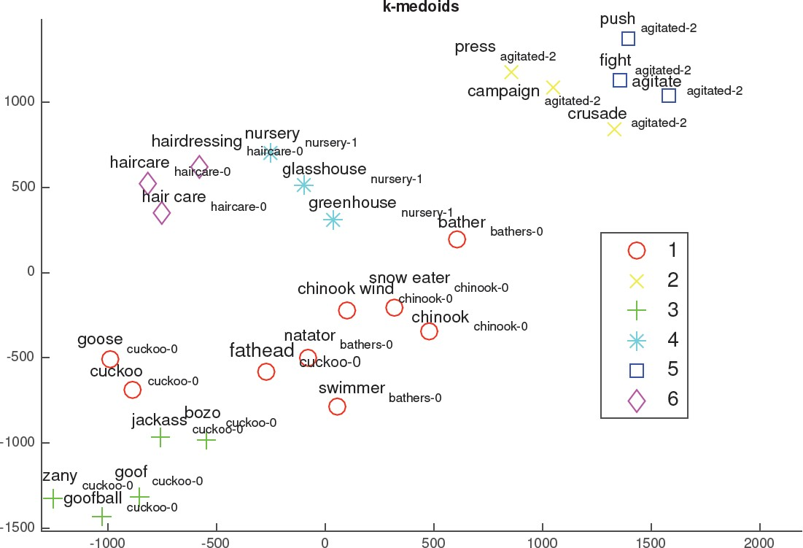
Intrinsic evaluation
Test relationships between words
Analogies
Clustering
Source: Michael Zhai, Johnny Tan, and Jinho
D. Choi. 2016. Intrinsic and extrinsic
evaluations of word embeddings

Slide 78
Intrinsic evaluation
Test relationships between words
Analogies
village town
country
happy
Clustering
city
gas oil
petroleum
Visualization
sad
joyful

Slide 79
Extrinsic evaluation
Test word embeddings on external task
e.g. named entity recognition, parts-of-speech tagging
Named entity
works at
person organization
Hilbert
Texa Textiles

Slide 80
Extrinsic evaluation
Test word embeddings on external task
e.g. named entity recognition, parts-of-speech tagging
+ Evaluates actual usefulness of embeddings
Time-consuming
More difficult to troubleshoot

Slide 81
Going further
Advanced language modelling and word embeddings
NLP and machine learning libraries
Keras
# from keras.layers.embeddings import Embedding
embed_layer = Embedding(10000, 400)
# import torch.nn as nn
embed_layer = nn.Embedding(10000, 400)
PyTorch

Slide 82
References
These slides have been adapted from
Younes Mourri & Lukasz Kaiser, Natural Language Processcing Specialization, DeepLearning.Ai

